Slide 1
Containers and closures (rubber)
-Aniketh shivashakthi
Roll no. 1
Final year B.Pharm

Slide 2
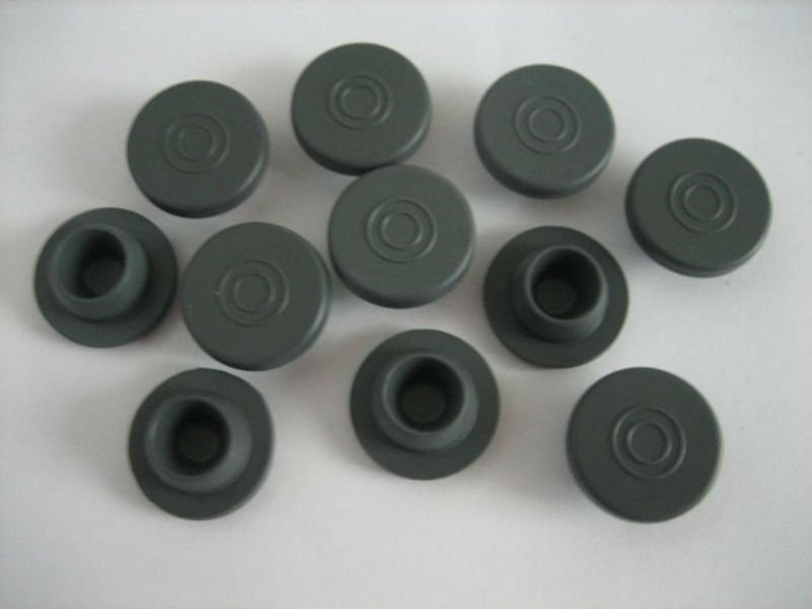

Slide 3
Containers
Container are an integral part of the formulation of an injection and may be considered as a component since there is no container that is totally insoluble or does not affect the liquid it contains
Therefore selection of a container fro particular injection must be based on the composition of the container as well as of the solution and treatment to which it will be subjected.

Slide 4
Types
Plastic
Rubber
Glass

Slide 5
Rubber
In order to permit the introduction of a needle from hypodermic syringe into a multiple dose vial mad provide for resealing of vial as soon as the needle is withdrawn, each vial is sealed with a rubble closure held in a place by an aluminium band or cap.

Slide 6
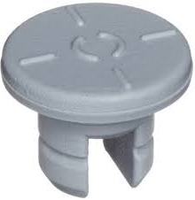
Rubber
Used to seal opening of vials, bottles and cartridges.
Important characteristics: Compressibility
Resealability
Mouldability
Most common type of closure is a flange stopper consisting of hollow plug and disc.
Lyophilizing stopper – slotted to permit escape of water vapour during freeze drying.

Slide 7
Examples of ingredient found in rubber closures
Ingredient | Example
Elastomer | Natural rubber(latex)
 | Butly rubber
 | Neoprene
Vulcanizing(curing agent) | Sulfur
 | Peroxides
Accelerator | Zinc dibutlydithiocarbamate
Activator | Zinc oxide
 | Stearic acid
Antioxidant | Dilauryl thiodipropionate
Plasticizer/lubricant | Paraffinic oil
 | Silicone oil
Fillers | Carbon black
 | Clay
 | Barium sulfate
Pigments | Inorganic oxides
 | Carbon black

Slide 8
Composition of Rubber
Fillers – Improves tensile strength, hardness, permeability. Increase abrasion resistance and reduce cost. e.g. carbon black, Kaolin, barium sulphate.
Plasticizers and lubricants- Assist mixing and moulding of rubber, softens the final rubber, adds lubricity to the closure. E.g. Paraffin oil, silicone oil, dibutyl phthalate.
Antioxidants – Protect against oxygen attack- e.g. Aromatic amines.
Pigments – Aesthetic appeal and to assign identity- e.g. Carbon black, inorganic salts and oxides, organic dyes.

Slide 9
Composition of Rubber
Rubber-Elastomer- Natural rubber (latex), butyl rubber , neoprene, polyisoprene, silicone, polybutadiene.
Vulcanizing agent- curing agent- reduces plasticity and improves resistance of rubber to changes in temperature. e.g. Sulphur, peroxides, oxides of Zn, Cd, Mg.
Accelerators- Increase the rate of vulcanisation- e.g . Guanidine derivatives.
Activators- React with accelerators and increase the rate of crosslinking. e.g . Zinc oxide , stearic acid.

Slide 10
Characteristic of good pharmaceutical rubber
Good ageing qualities.
Satisfactory hardness and elasticity.
Resistance to sterilisation conditions.
Impermeable to moisture and air.
Negligible release of undesirable substance.
Negligible extraction of injection ingredients.

Slide 11
Problems associated with Rubber
If closure is incompatible, solution can be discolored, turbid and degraded.
Surfactants from solution can extract chemicals from the closure- Instability.
Loss of preservatives due to adsorption.
Closure can permit transfer of moisture.
Coring- generation of rubber particles from the closure when needles or medical devices are inserted. Rubber closures on refrigerated products are more prone to coring.
Coring indicated compromise in the composition to obtain a rubber closure with good stability.

Slide 12
Problems associated with Rubber
Leaching- Natural > Butyl > Silicone
Permeation- Silicone > Natural > Butyl
Adsorption – Natural > Butyl > Silicone
Butyl and silicone- saturated elastomers
Natural and Neoprene – Unsaturated elastomers.
 | Physical properties | Chemical properties
Highly Unsaturated | Excellent | poor
Saturated | Poor | Excellent

Slide 13
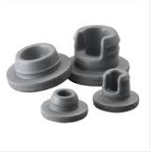
Rubber closures
Cleaning-
Difficult because of rough elastic and convoluted surface.
Gentle agitation in hot solution of mild detergent, Sodium pyrophosphate.
Several rinses or continuous washing with filtered water.
Final rinse with WFI in front of laminar flow unit.
Wet closures autoclaved, water drained and dried under vacuum.

Slide 14
Testing
Preliminary compatibility- Rubber closure placed in intimate contact with product at elevated temperature.
Physiochemical tests on aqueous extracts-
pH
Turbidity
Residue on drying
Iodine number
Heavy metal content.
Biological tests on saline, PEG 400 and cotton seed oil extracts include acute and chronic toxicity in mice and rabbits.

Slide 15
Quality control
Quality
Finish
Penetrability
Fragmentation
Self seal ability
Water extractive
Acid or alkali
Compatibility with contents
Penetrability to water vapour

Slide 16
Self-seal ability.
This test is applicable to closures intended
use a new hypodermic needle with an external diameter of
0.8 mm (21 SWG) and pierce the closure 10 times, piercing
each time at a different site. Immerse the vials upright in a
0.1 per cent w/v solution of methylene blue and reduce the
external pressure by 27kPa for 10 minutes. Restore the
atmospheric pressure and leave the vials immersed for
30 minutes. Rinse the outside of the vials. None of the vials
contains any trace of coloured solution.

Slide 17
Quality
The closures must be not tacky after washing several times, autoclaving for half an hour at 121°C in distilled water and drying for a day at 65

Slide 18
Finish
They must be free from dust, fibres, rubbers, smears of grease and pigment

Slide 19
Fragmentation test.
Place a volume of water corresponding to nominal volume minus 4ml in each of 12 clean vial
↓
Close vial with closure and secure caps for 16hours
↓
Pierce the closures with 21 SWG hypodermic needle and inject 1ml water and remove 1ml air
↓
Repeat the above operation 4times for each closure
↓
Count the number of fragments visible to the naked eye
↓
Total number of fragments should not be more than 10 except butyl rubber where the fragment should not exceed 15

Slide 20
Water extractive
A four hour extract to boiling wartr is made under reflux and evaporated to dryness
The residue must not exceed the specified amount

Slide 21
Sterilisation test.
The closures ‘prepared’ in the aforementioned manner shall not soften or become tacky and there shall be no visual change in the closure.

